Slide 1

Welcome to our
MATHEMATICS
Class
Prepared by: Mr. Fajardo

Slide 2
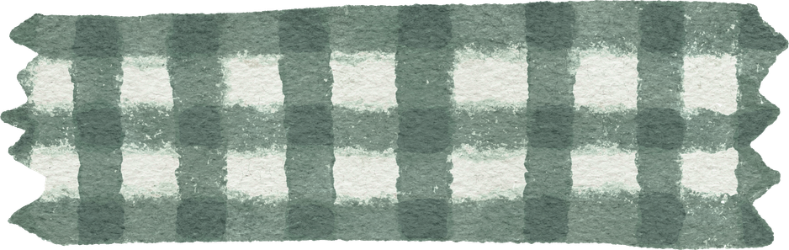
Learning Objectives
Describe the relationship between the coefficients and the roots of a quadratic equation.
Determine the sum and product of the roots of a quadratic equation

Slide 3
Quadratic formula

Slide 4
Real or not
Classify each expression as Real Number or Not a Real Number.

Slide 5
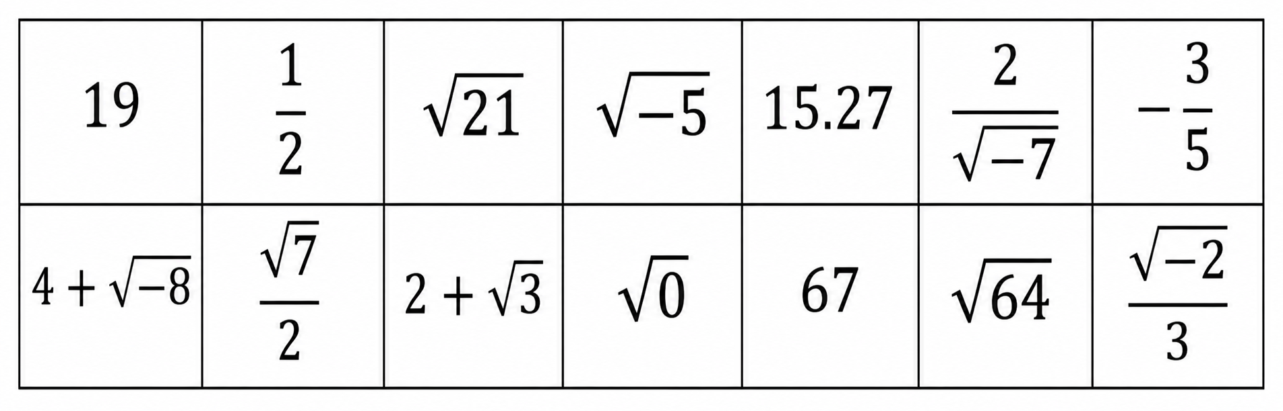
Classify each expression as Real Number or Not a Real Number.

Slide 6
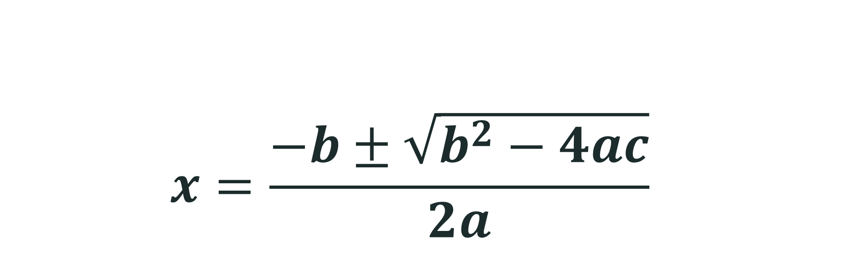
Let’s Recall the Quadratic Formula
$$x=\frac{−b±\sqrt{b^{2}−4ac}}{2a}$$

Slide 7
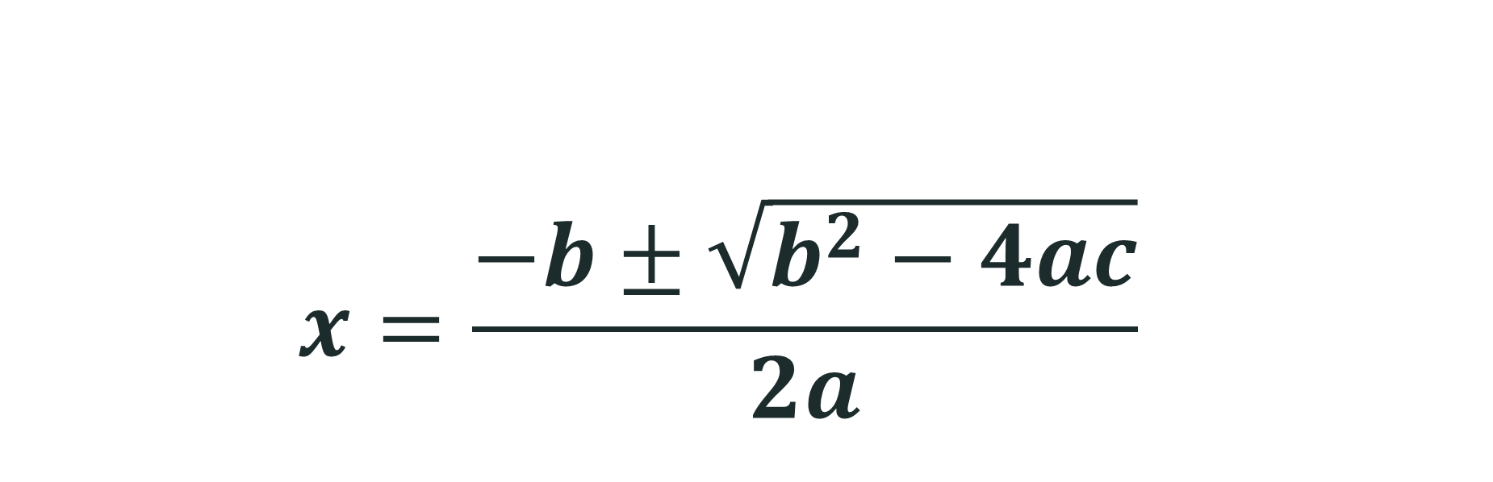
Let’s Recall the Quadratic Formula
$$x=\frac{−b±\sqrt{b^{2}−4ac}}{2a}$$
Which part of the quadratic formula involves finding a square root?

Slide 8
discriminant
Nature of Roots
(pp. 20 – 22)

Slide 9
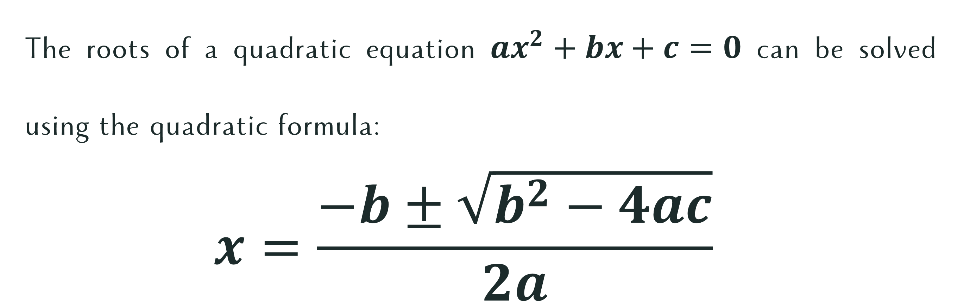
Discriminant
The roots of a quadratic equation $ax^{2}+bx+c=0$ can be solved using the quadratic formula:
$$x=\frac{−b±\sqrt{b^{2}−4ac}}{2a}$$

Slide 10
Discriminant
The roots of a quadratic equation $ax^{2}+bx+c=0$ can be solved using the quadratic formula:
$$x=\frac{−b±\sqrt{b^{2}−4ac}}{2a}$$
Discriminant

Slide 11
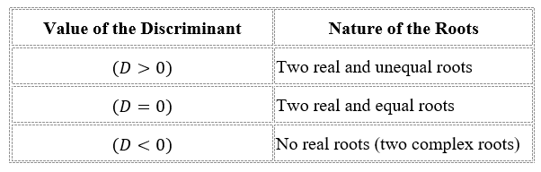
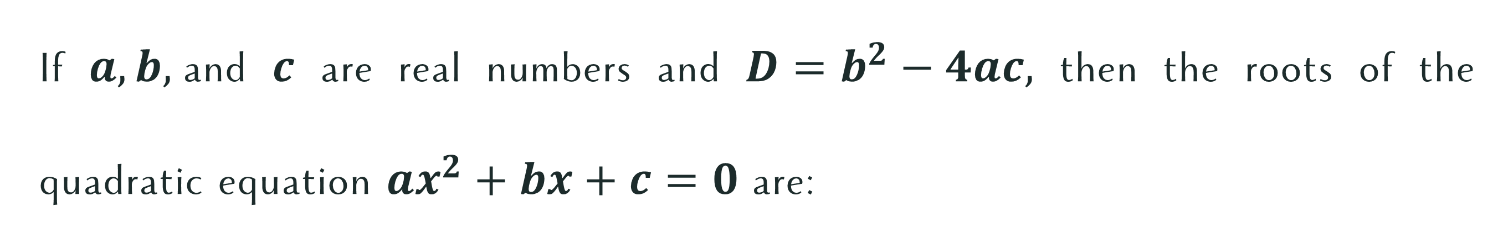
Nature of Roots
If $a, b,$and $c$ are real numbers and $D=b^{2}−4ac,$ then the roots of the quadratic equation $ax^{2}+bx+c=0$ are:

Slide 12

Let’s Try This!
Determine the nature of the roots of the quadratic equations.
$x^{2}−5x+6=0$
$x^{2}+6x+5=0$
$5x^{2}−x+2=0$

Slide 13
Complete Me!
Complete the statements.
If the discriminant is positive, the quadratic equation has ____________.
If the discriminant is negative, the quadratic equation has ___________.
If the discriminant is zero, the quadratic equation has _______________.

Slide 14

Try This!
Without solving the equations, characterize the nature of the roots.
$x^{2}−9x+18=0$
$2x^{2}+8x+9=0$
$24x^{2}−2x=15$
$6x^{2}−3=8x$
$5x^{2}−6x+8=0$

Slide 15
Compassion
Just as we carefully examine the discriminant before making conclusions about the roots, why is it important to understand a person's situation before judging them?

